Slide 1
Copyright © 2014 Pearson Education, Inc.

Slide 2
Chapter 1
The Revolution Is Just Beginning
Copyright © 2014 Pearson Education, Inc.

Slide 3
Pinterest: A Picture Is Worth a
Thousand Words
Have you used Pinterest or any other content curation sites? What are your main interests?
Have you purchased anything based on a pin or board on Pinterest or any other curation site?
Why do Pinterest links drive more purchasing than Facebook links?
Copyright © 2014 Pearson Education, Inc.
Slide 1-<number>

Slide 4
E-commerce Trends 2012–2013
Mobile platform solidifies
Mobile e-commerce explodes
Continued growth of social networks
Expansion of social and local
e-commerce
Explosive growth in “Big Data”
E-books gain wide acceptance
Copyright © 2014 Pearson Education, Inc.
Slide 1-<number>

Slide 5
The First 30 Seconds
First 17 years of e-commerce
  Just the beginning
  Rapid growth and change
Technologies continue to evolve at exponential rates
  Disruptive business change
  New opportunities
Copyright © 2014 Pearson Education, Inc.
Slide 1-<number>

Slide 6
What Is E-commerce?
Use of Internet and Web to transact business
More formally:
  Digitally enabled commercial transactions between and among organizations and individuals
Copyright © 2014 Pearson Education, Inc.
Slide 1-<number>

Slide 7
Why Study E-commerce?
E-commerce technology is different, more powerful than previous technologies
E-commerce brings fundamental changes to commerce
Traditional commerce:
  Consumer as passive targets
  Sales-force driven
  Fixed prices
  Information asymmetry
Copyright © 2014 Pearson Education, Inc.
Slide 1-<number>

Slide 8
Eight Unique Features of
E-commerce Technology
Ubiquity
Global reach
Universal standards
Information richness
Interactivity
Information density
Personalization/customization
Social technology
Copyright © 2014 Pearson Education, Inc.
Slide 1-<number>

Slide 9
Web 2.0
User-centered applications and social media technologies
  User-generated content and communication
  Highly interactive, social communities
  Large audiences; yet mostly unproven business models
  e.g.: Twitter, YouTube, Facebook, Instagram, Wikipedia, StumbleUpon, Tumblr, Pinterest
Copyright © 2014 Pearson Education, Inc.
Slide 1-<number>

Slide 10
Types of E-commerce
    May be classified by market relationship or technology
Business-to-Consumer (B2C)
Business-to-Business (B2B)
Consumer-to-Consumer (C2C)
Social e-commerce
Mobile e-commerce (M-commerce)
Local e-commerce
Copyright © 2014 Pearson Education, Inc.
Slide 1-<number>

Slide 11
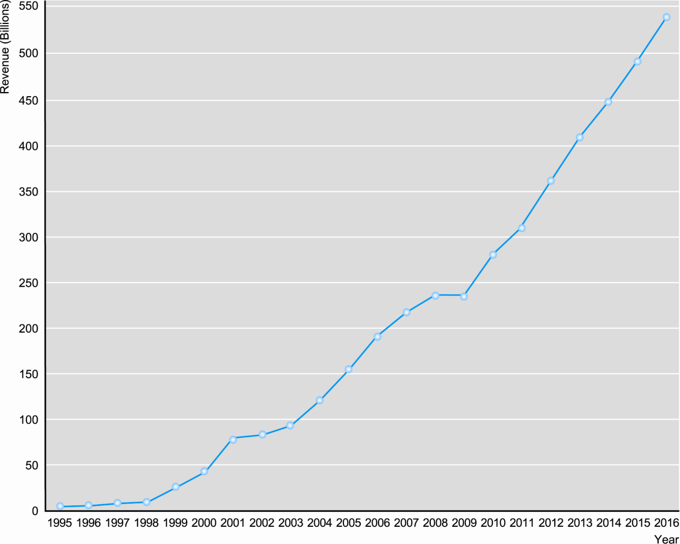
The Growth of B2C E-commerce
Figure 1.1, Page 13
SOURCE: Based on data from eMarketer, Inc., 2012; authors’ estimates.
Copyright © 2014 Pearson Education, Inc.
Slide 1-<number>

Slide 12
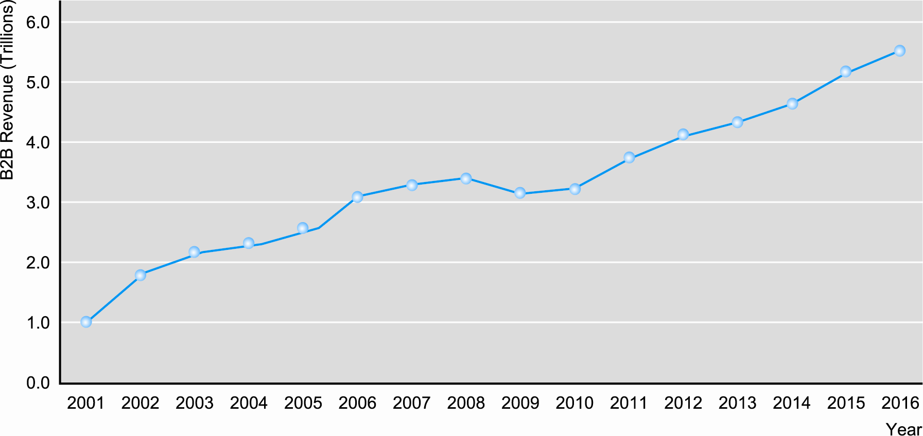
The Growth of B2B E-commerce
Figure 1.2, Page 14
SOURCE: Based on data from U.S. Census Bureau, 2012b; authors’ estimates.
Copyright © 2014 Pearson Education, Inc.
Slide 1-<number>

Slide 13
The Internet
Worldwide network of computer networks built on common standards
Created in late 1960s
Services include the Web, e-mail, file transfers, etc.
Can measure growth by looking at number of Internet hosts with domain names
Copyright © 2014 Pearson Education, Inc.
Slide 1-<number>

Slide 14
The Web
Most popular Internet service
Provides access to Web pages
  HTML documents that may include text, graphics, animations, music, videos
Web content has grown exponentially
  Google reports one trillion unique URLs; 120 billion Web pages indexed
Copyright © 2014 Pearson Education, Inc.
Slide 1-<number>

Slide 15
Origins and Growth of E-commerce
1995: Beginning of e-commerce
  First sales of banner advertisements
E-commerce fastest growing form of commerce in United States
Copyright © 2014 Pearson Education, Inc.
Slide 1-<number>

Slide 16
E-commerce: A Brief History
1995–2000: Invention
  Key concepts developed
  Dot-coms; heavy venture capital investment
2001–2006: Consolidation
  Emphasis on business-driven approach
2006–Present: Reinvention
  Extension of technologies
  New models based on user-generated content, social networks, services
Copyright © 2014 Pearson Education, Inc.
Slide 1-<number>

Slide 17
Early Visions of E-commerce
Computer scientists:
  Inexpensive, universal communications and computing environment accessible by all
Economists:
  Nearly perfect competitive market;
  friction-free commerce
  Lowered search costs, disintermediation, price transparency, elimination of unfair competitive advantage
Entrepreneurs:
  Extraordinary opportunity to earn far above normal returns on investment—first mover advantage
Copyright © 2014 Pearson Education, Inc.
Slide 1-<number>

Slide 18
Is the Party Already Over?
What explains the rapid growth in private investment in e-commerce firms in the period 2011 to early 2012? Was this investment irrational?
Despite the ubiquitous popularity of Facebook, its IPO was a failure—why?
Why do you think investors today are interested in investing in or purchasing social network companies?
What other types of e-commerce companies, if any, would you be interested in purchasing or investing in, and why?
Copyright © 2014 Pearson Education, Inc.
Slide 1-<number>

Slide 19
Understanding E-commerce: Organizing Themes
Technology:
  Development and mastery of digital computing and communications technology
Business:
  New technologies present businesses with new ways of organizing production and transacting business
Society:
  Intellectual property, individual privacy, public welfare policy
Copyright © 2014 Pearson Education, Inc.
Slide 1-<number>

Slide 20
Facebook and the Age of Privacy
Why are social network sites interested in collecting user information?
What types of privacy invasion are described in the case? Which is the most privacy-invading, and why?
Is e-commerce any different than traditional markets with respect to privacy? Don’t merchants always want to know their customer?
How do you protect your privacy on the Web?
Copyright © 2014 Pearson Education, Inc.
Slide 1-<number>

Slide 21
Academic Disciplines
Concerned with E-commerce
Technical approach
  Computer science
  Management science
  Information systems
Behavioral approach
  Information systems
  Economics
  Marketing
  Management
  Finance/accounting
  Sociology
Copyright © 2014 Pearson Education, Inc.
Slide 1-<number>

Slide 22

Copyright © 2014 Pearson Education, Inc.
Slide 1-<number>

